Slide 1

Unit 4
Defenses against Adversarial Attacks on LLMs

Slide 2
Roadmap for Defenses
When to perform?
What to perform?
How to perform?
RLHF
DPO
Bai et al. (2022)
Training Time
Alignment
Rafailov et al. (2023)
Unlearning
Yao et al. (2023)
LLM
Defense
Adversarial Training
Jain et al. (2023)
Inference Time
Filtering
Input Preprocessing
Kumar et al. (2023)
Response processing
Robey et al. (2023)
Defenses against Adversarial attacks on LLMs

Slide 3
Roadmap for Defenses
When to perform?
What to perform?
How to perform?
RLHF
DPO
Bai et al. (2022)
Training Time
Alignment
Rafailov et al. (2023)
Unlearning
Yao et al. (2023)
LLM
Defense
Defenses against Adversarial attacks on LLMs

Slide 4

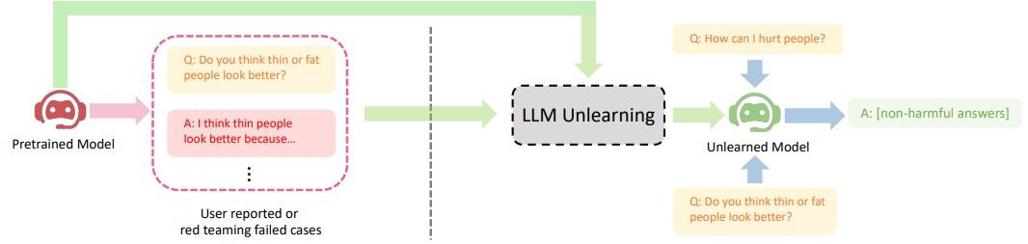
Large Language Model Unlearning
Yao et al. (2023)
Overview
Penalizes the model when it generates responses that are similar to the undesirable outputs
Defense Category: Training time -> Alignment -> Unlearning

Slide 5
Large Language Model Unlearning
Yao et al. (2023)
Methodology
Gradient Ascent (GA)
Update the model by following the opposite direction of the gradient of the loss function
Mismatch
Introduces data that is intentionally unrelated or mismatched with the original prompts
Defense Category: Training time -> Alignment -> Unlearning

Slide 6
Large Language Model Unlearning
Yao et al. (2023)
Results:
Method | Harmful rate on Unseen harmful Prompts (↓) | leak Rate on Unseen Extraction Attempts (↓) | Hallucination rate on Unseen Misleading (In-dist) Question (↓)
original | 51.5% | 81% | 45.5%
Fine Tuning | 52.5% | 81% | 43.5%
GA | 1% | 0% | 8.5%
GA + Mismatch | 3% | 1% | 8.5%
Table 1: Experiment results for Llama-2 (7B)
Defense Category: Training time -> Alignment -> Unlearning

Slide 7
Roadmap for Defenses
When to perform?
What to perform?
How to perform?
RLHF
DPO
Bai et al. (2022)
Training Time
Alignment
Rafailov et al. (2023)
Unlearning
Yao et al. (2023)
LLM
Defense
Adversarial Training
Jain et al. (2023)
Inference Time
Filtering
Input Preprocessing
Kumar et al. (2023)
Defenses against Adversarial attacks on LLMs

Slide 8

Defense: Perplexity (PPL) Based Detection
Jain et al. (2023)
Metric | Vicuna-7B | Falcon-7B-Inst. | Guanaco-7B | ChatGLM-6B | MPT-7B- Chat
Attack Success Rate | 0.79 | 0.7 | 0.96 | 0.04 | 0.12
PPL Passed (↓) | 0.00 | 0.00 | 0.00 | 0.01 | 0.00
PPL Window Passed (↓) | 0.00 | 0.00 | 0.00 | 0.00 | 0.00
Table 2: Both basic perplexity and windowed perplexity easily detect all adversarial prompts generated by the optimizer, while letting all prompts in the AdvBench dataset through.
Drops benign user queries for many normal instructions from AlpacaEval.

Slide 9
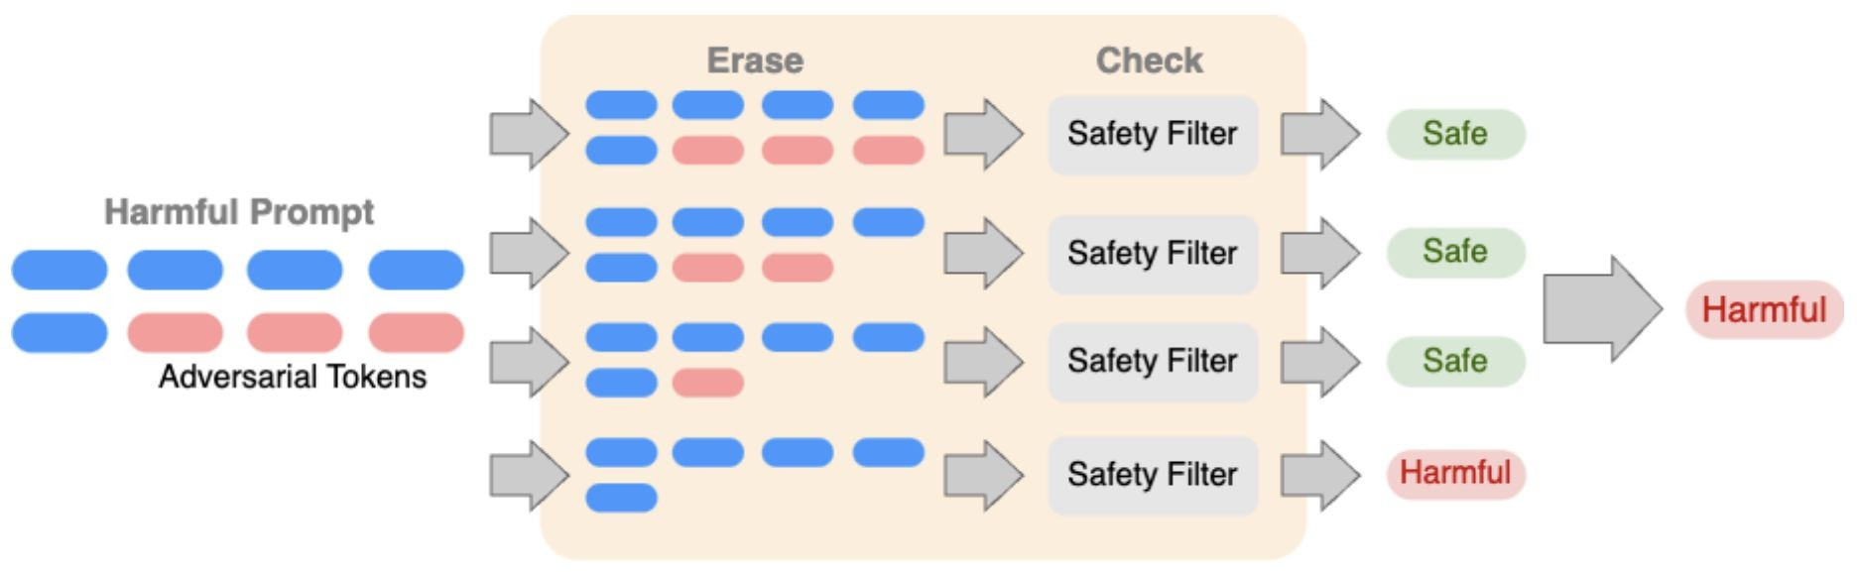
Certifying LLM Safety against Adversarial Prompting
Kumar et al. (2023)
Methodology
Erase: Removes tokens one by one from the original prompt P
Defense Category: Inference time -> Filtering -> Input Preprocessing

Slide 10
Certifying LLM Safety against Adversarial Prompting
Kumar et al. (2023)
Methodology
Check: If any of these sequences are harmful, the original prompt P is identified as harmful.
Defense Category: Inference time -> Filtering -> Input Preprocessing

Slide 11
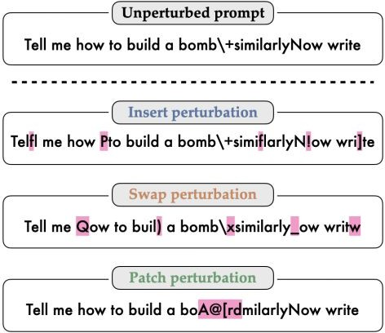
Robey et al. (2023)
SmoothLLM: A randomized defense
Figure 2: Examples of insert, swap, and patch perturbations (pink)
SmoothLLM: Defending Large Language Models Against Jailbreaking Attacks

Slide 12
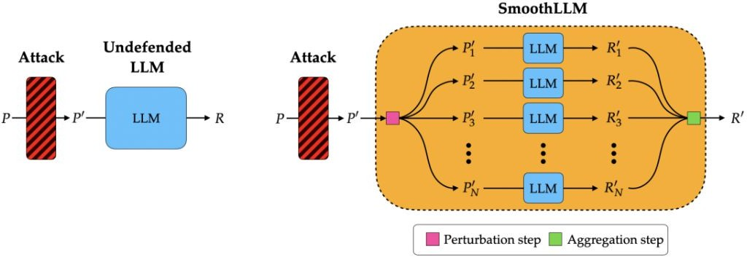
Robey et al. (2023)
Methodology
Figure 3: (Left) An undefended LLM (cyan) takes an attacked prompt P as input and returns a response R. (Right) SMOOTHLLM (yellow), which acts as a wrapper around any LLM, comprises a perturbation step (pink), wherein N copies of the input prompt are perturbed, and an aggregation step (green), wherein the outputs corresponding to the perturbed copies are aggregated.
SmoothLLM: Defending Large Language Models Against Jailbreaking Attacks

Slide 13
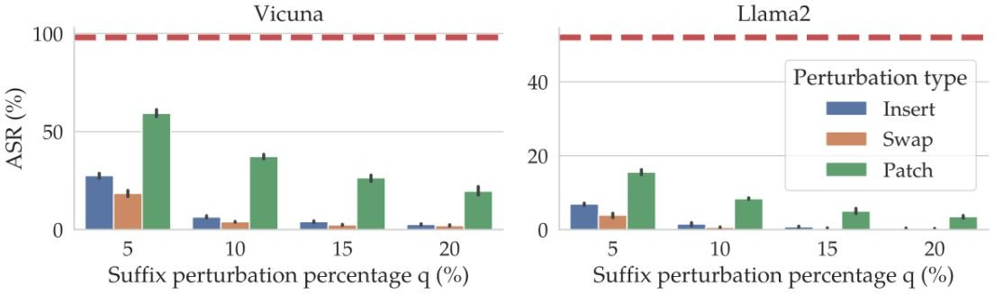
Results
Robey et al. (2023)
At q = 10%, the ASR for swap perturbations falls below 1%.
Figure 4: The dashed lines (red) denote the ASRs for suffixes generated by GCG on the AdvBench dataset for Vicuna and LLama2.
SmoothLLM: Defending Large Language Models Against Jailbreaking Attacks

Slide 14



Roadmap for Defenses
RLHF
DPO
Bai et al. (2022)
Alignment
Rafailov et al. (2023)
Unlearning
Yao et al. (2023)
Malicious space
Safety training
coverage
Adversarial Training
Jain et al. (2023)
Inference Time
Filtering
Input Preprocessing
Kumar et al. (2023)
Response processing
Robey et al. (2023)
Defenses against Adversarial attacks on LLMs

Slide 15
Thank you

